Slide 1



An Introduction to Kubernetes
Terry McCann | @SQLShark

Slide 2
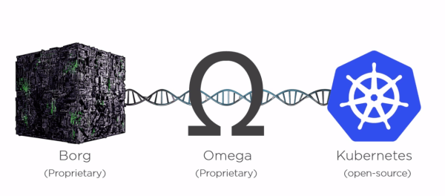

Slide 3

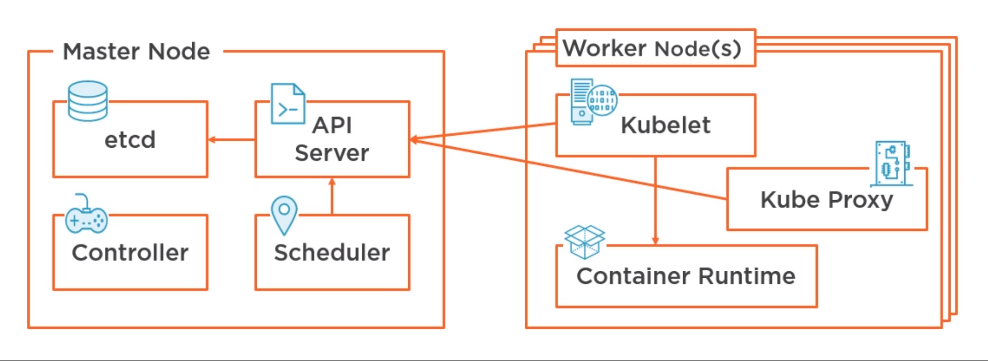
Terry McCann 2018
Notes:
• How to Use the WHERE Clause
• Overview of Operators
• Filter Data by Using Comparison Operators
• Filter Data by Using String Comparisons
• Filter Data by Using Logical Operators
• Filter Data Using a Range of Values
• Filter Data Using a List of Values
• Working with NULL Values
• Introducing Native SQL Server Functions
• Functions Relating to NULL Values

Slide 4


Questions?
Shout them out!!

Slide 5
Who is a Software developer?

